Slide 1




Public Transport
Post COVID

Slide 2
Outline
The Problem
Solution Proposal
Wireframes
Next Steps

Slide 3
The Problem

Slide 4
Problem statement
Since cases in Mumbai are increasing rapidly and with BEST transport functioning in the city, it has become difficult to cope up with fighting the virus, people need to travel, and public transport is the lifeline of the Mumbai.

Slide 5
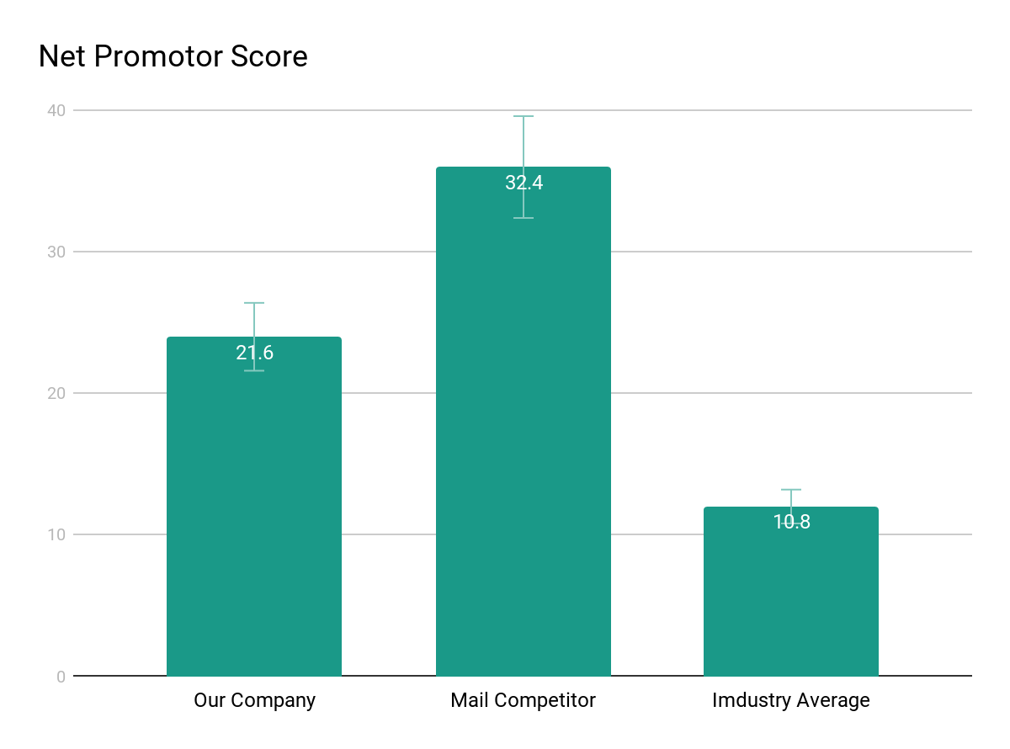
Our Prototype Route
1
We have done research and found a bus route that is both, used by people and affected by COVID19
Juhu Santacruz Bandra

Slide 6
Crowdsourcing data is difficult
82%
Of people are concerned about COVID and would definitely report others in real time
Relying on human reports for too long is not feasible

Slide 7
Solution Proposal

Slide 8
Solution description
We will collect reports on mask and coughs, etc calculating the risk factor which is allowing users to be aware of the situation inside the bus before entering. Data is sensitive and will be stored on blockchain, computer vision will be used to train our ML model and in the future reports will not be necessary.

Slide 9
Wireframes

Slide 10
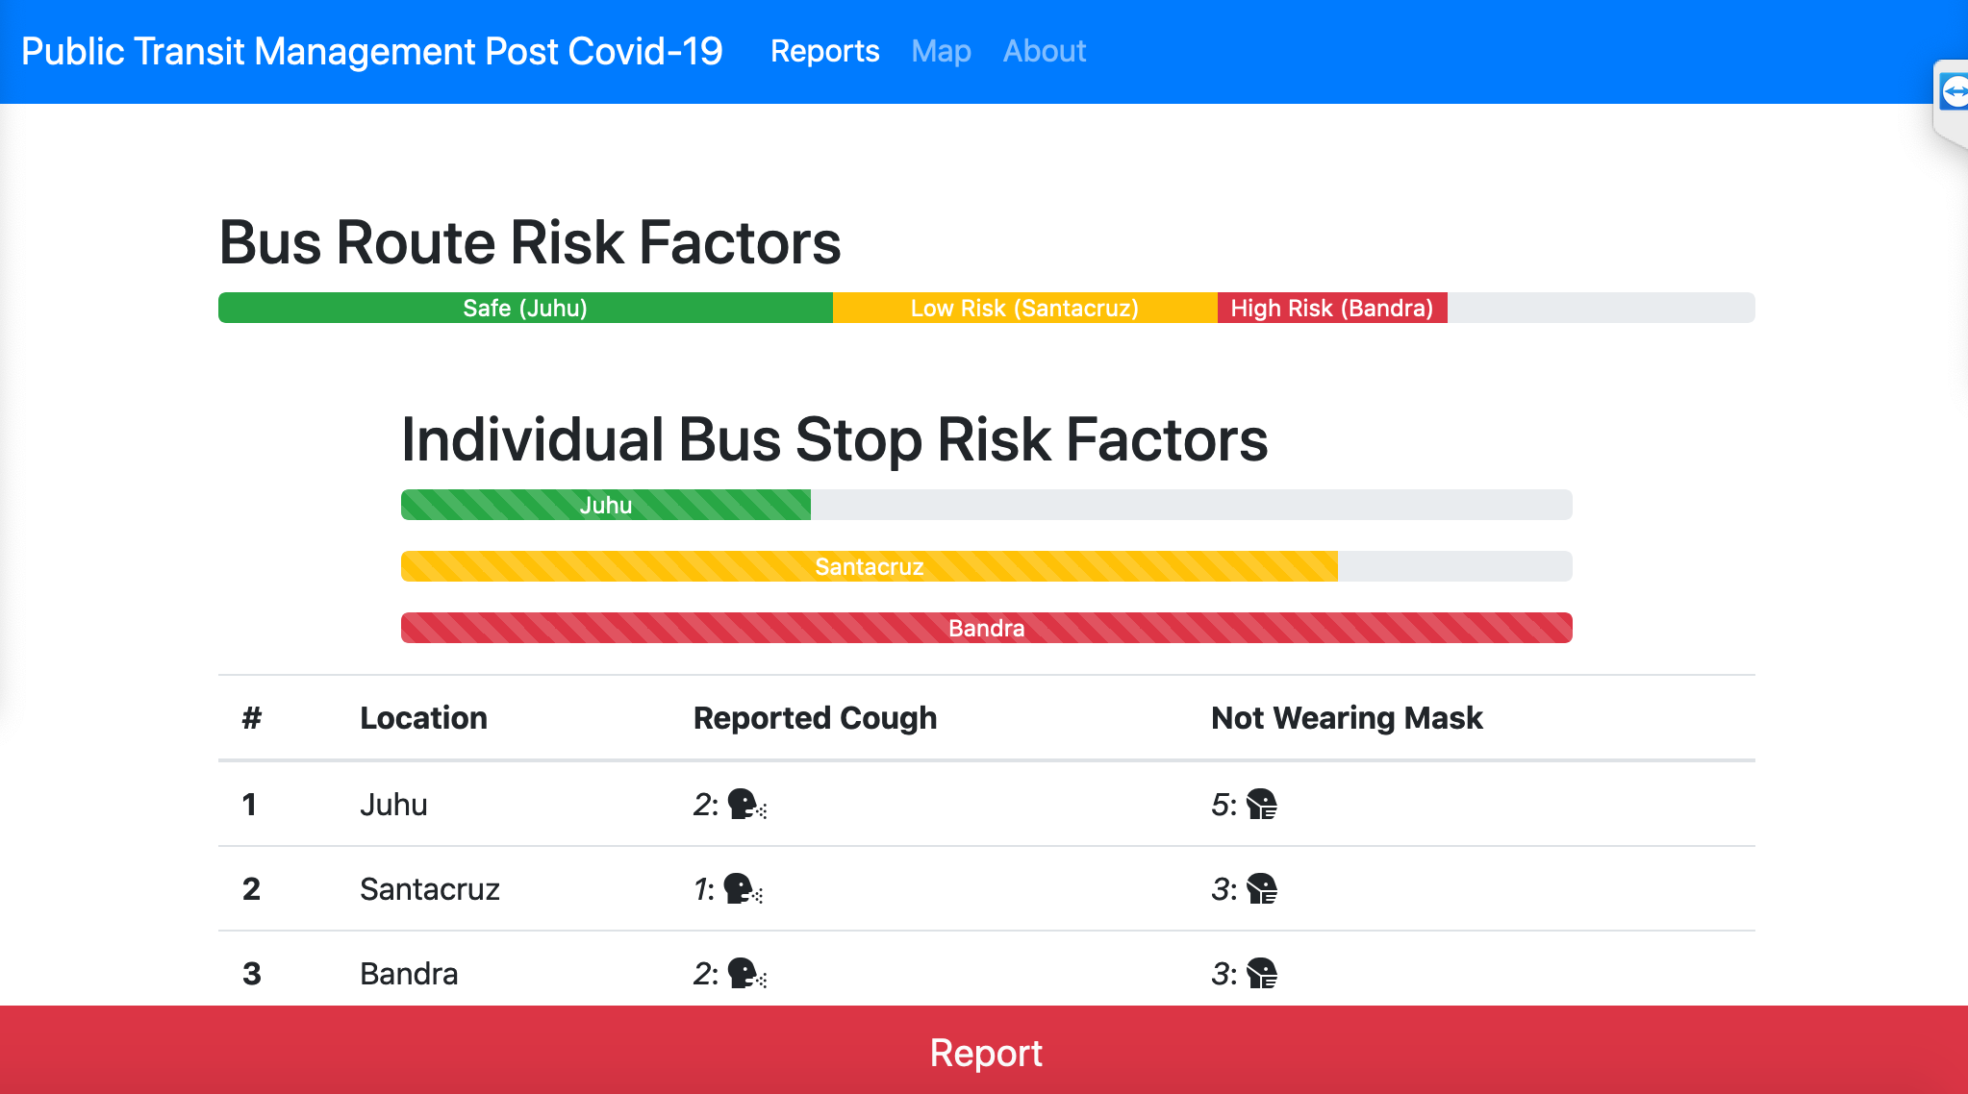

Information architecture
Live Risk Factors along the GPS route of the BUS
Balsamiq Tip | Information architecture is the flow of content across the site or application (more info).

Slide 11
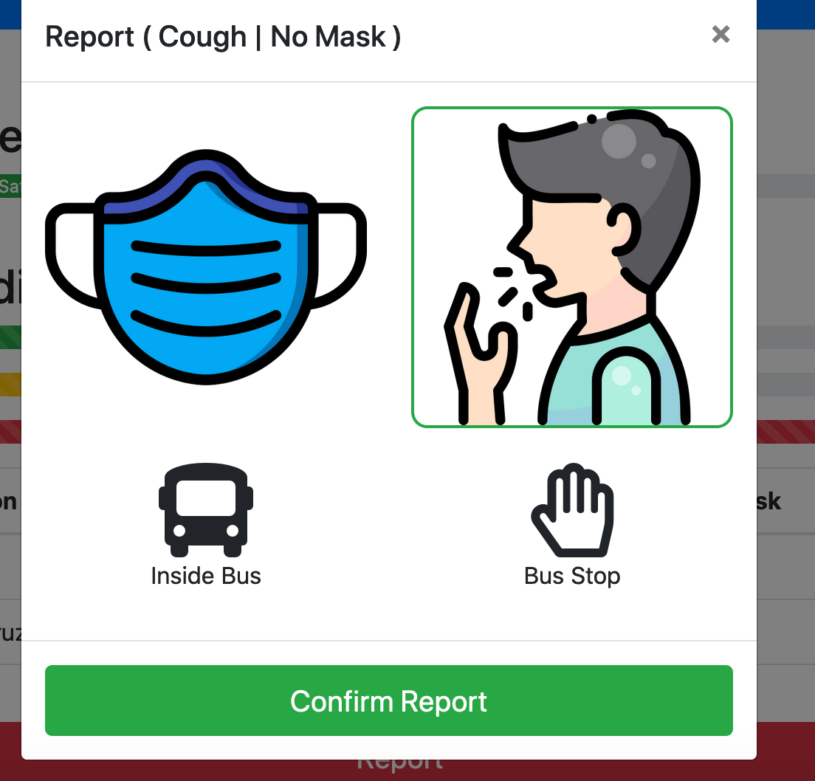
Report Button
Type of report

Slide 12
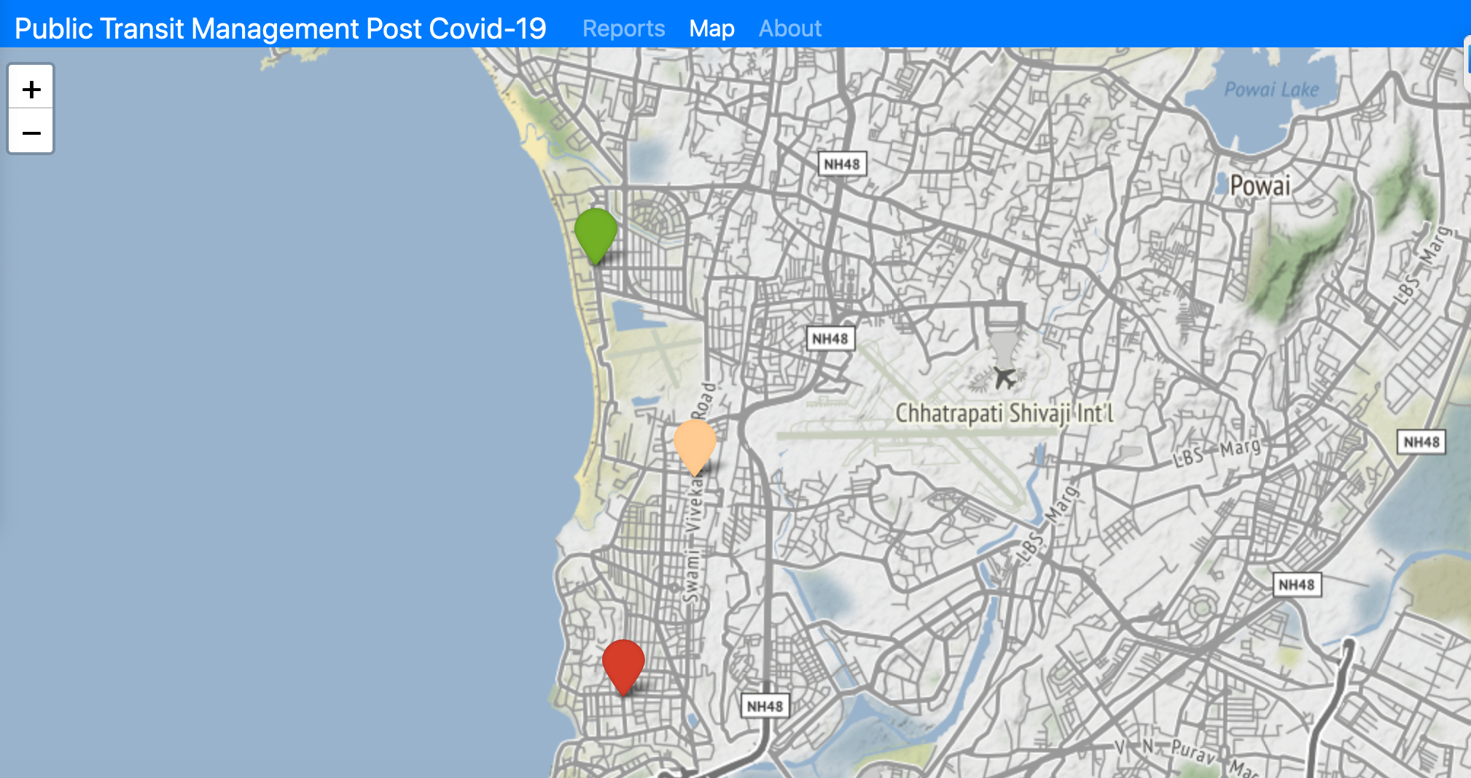
Map
A live GPS map along with risk factor at each stop

Slide 13
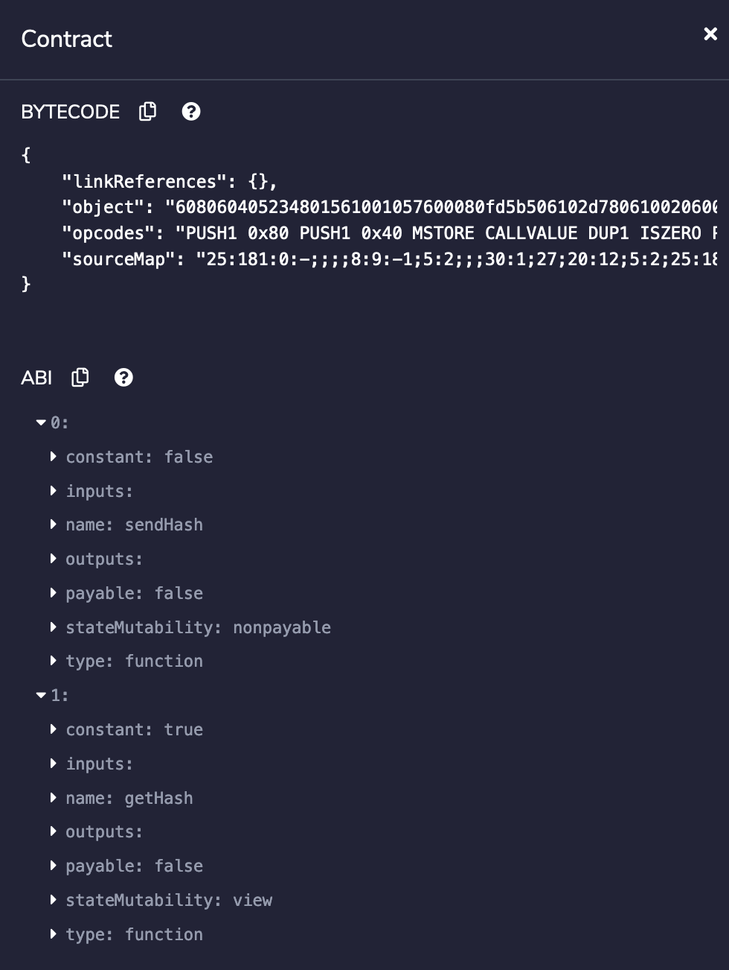
Map
Ethereum smart contract

Slide 14
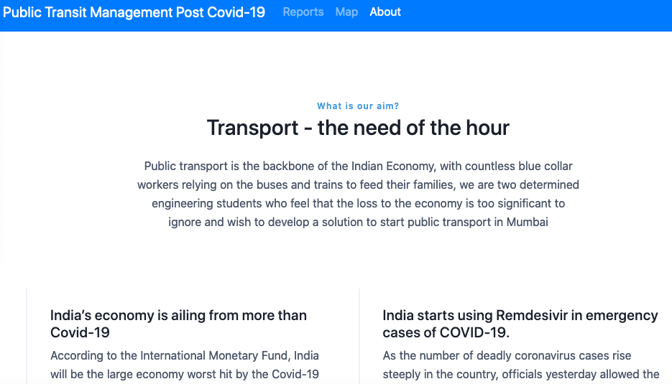
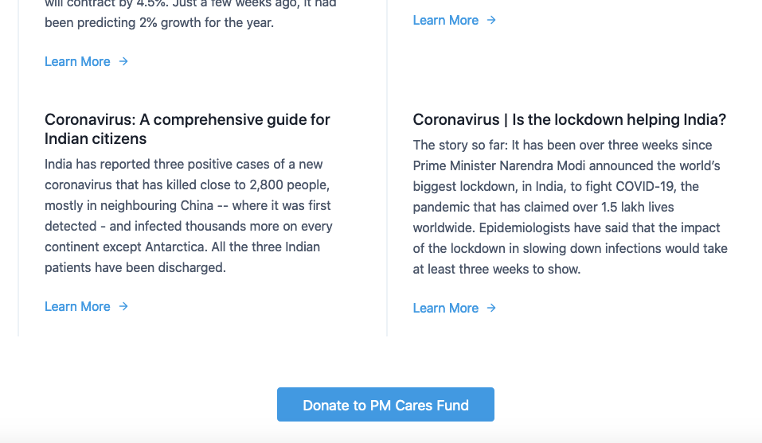
Map
Some interesting news chosen by our algorithm according to your location and nature(reporting frequency etc

Slide 15
Next Steps

Slide 16
Future Scope
Integrate Computer Vision to help train our ML model with the manual user reports
Live GPS updates with a better risk factor calculation
Complete integration of data on blockchain -> currently we stored the has of reports on the ethereum ropsten test network successfully with IPFS
Adding a chatbot to have extra data which can be used with a lower weight for our ML model

Slide 17
Timeline
Current stage:
Prototype
MAY
May
June
June
July
August
NOV
research
Design
Development
Testing
Prototype
Beta User testing
Rollout

Slide 18
Thank You :D

